Slide 1

Property, Plant & Equipment Part 1 – In-Class

Slide 2
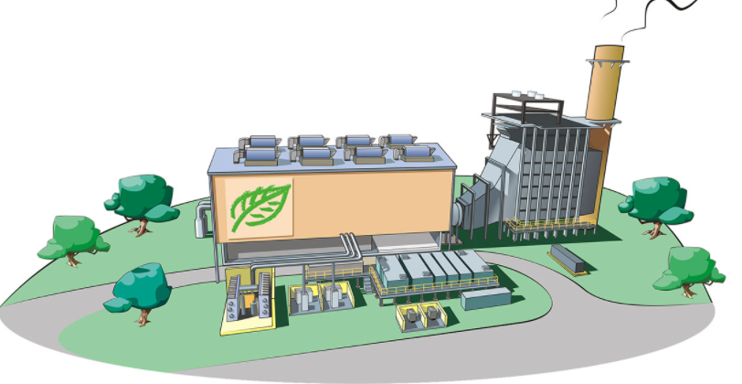
Today’s Plan
Interest Capitalization
Depreciation Methods
Improvements/repairs
Post Acquisition Expenditures

Slide 3
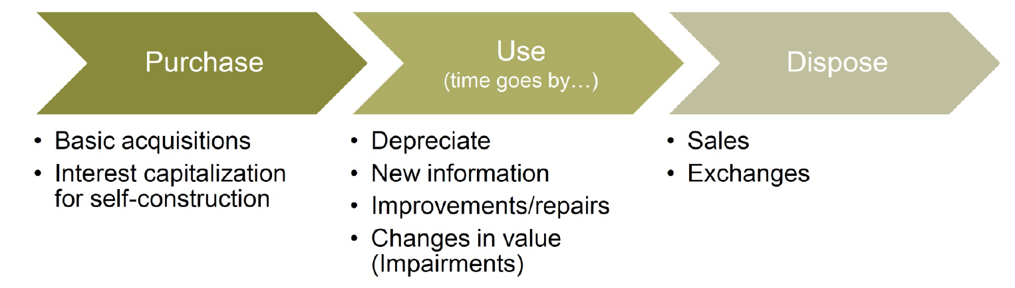

PP&E Life Cycle

Slide 4
Interest Capitalization

Slide 5
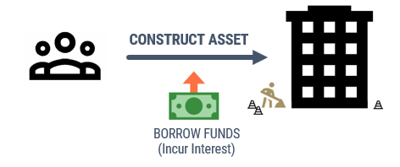
Interest Capitalization
Interest can be capitalized (put on balance sheet) if:
There are expenditures towards the asset
Activities to prepare the asset are in progress
Interest is being incurred

Slide 6
Interest Capitalization
Pay Actual Interest on
All Outstanding Debt
Interest Expense
(Income Statement)
Interest on construction loans
Interest on general debt (i.e., notes payable, bonds payable, mortgage payable)
Capitalized Interest
(Balance Sheet)
Known as avoidable interest
Do not expense immediately – expensed later with depreciation

Slide 7
Interest Capitalization
“Avoidable interest” is interest expense that is dedicated to the construction (i.e., it is avoidable if there is no construction)
Qualifying assets require time to prepare for intended use
Assets under construction for the company’s own use
Assets constructed/produced for sale or lease
Capitalization period
Begins when 1. expenditures made, 2. activities in progress, and 3. interest being incurred
Ends when asset substantially complete and ready for use
Journal Entry
Construction in Progress (B-A) XX
Cash (B-A) [or Payable] XX
Notes:
I start making payments for construction. If I have to take out a loan to make these payments, that interest would otherwise be avoidable.

Slide 8
Interest capitalization: Step 1
Step 1: Record expenditures in Construction in Process (B-A) and calculate weighted-average accumulated expenditures (aka weighted-average funding needs)
Journal Entry
Construction in Progress (B-A) xx
Cash (B-A) or A/P (B-L) xx
Calculate weighted-average accumulated expenditures
For each expenditure, multiply the amount by the capitalization period (fraction of period between expenditure and end of period).
Sum the weighted expenditures to get the weighted-avg accumulated expenditures
This is the amount for which we can calculate avoidable interest

Slide 9
Interest capitalization: Step 1 Example
Sprout Co. has a construction project throughout all of 2021. During the first year of construction, Sprout incurred the following expenditures (assume paid in cash):
April 1, 2021 $500,000
July 1, 2021 $600,000
December 1, 2021 $900,000
Record the journal entries for each expenditure.
4/1/21 Construction in Progress (B-A) 500,000
Cash (B-A) 500,000
7/1/21 Construction in Progress (B-A) 600,000
Cash (B-A) 600,000
12/1/21 Construction in Progress (B-A) 900,000
Cash (B-A) 900,000

Slide 10
Interest capitalization: Step 1 Example
Sprout Co. has a construction project throughout all of 2021. During the first year of construction, Sprout incurred the following expenditures (assume paid in cash):
April 1, 2021 $500,000
July 1, 2021 $600,000
December 1, 2021 $900,000
Calculate the weighted-average accumulated expenditures.
Capitalization Period = What proportion of the year would Annual loans be used.
x 9 mos / 12 mos = 375,000
x 6 mos / 12 mos = 300,000
x 1 mos / 12 mos = 75,000
$750,000

Slide 11
Interest capitalization: Step 2
Step 1: Record expenditures in Construction in Process (B-A) and calculate weighted-average accumulated expenditures (aka weighted-average funding needs)
Step 2: Determine interest rate to use
First, use the interest rate for project-related loans on the weighted-avg accumulated expenditures up to the loan amount
For remaining weighted-avg accumulated expenditures, use weighted-average interest rate on general (non-project) debt

Slide 12
Interest capitalization: Step 2 Example
Sprout Co. has the following debt for 2021:
Construction-specific loan $500,000 at 7% interest rate
Note payable $1,000,000 at 10% interest rate
Bond payable $250,000 at 8% interest rate
Determine appropriate interest rates.
General debt
Project-specific Debt:
Construction-specific loan 7%
General Debt (need weighted-average interest rate):
LOAN INTEREST
Note Payable $1,000,000 x 10% = $100,000
Bond Payable $ 250,000 x 8% = $20,000
$1,250,000 $120,000
120,000 / 1,250,000 = 9.6% weighted-avg interest rate for general debt

Slide 13
Interest capitalization: Step 3
Step 1: Record expenditures in Construction in Process (B-A) and calculate weighted-average accumulated expenditures (aka weighted-average funding needs)
Step 2: Determine interest rate to use
First, use the interest rate for project-related loans on the weighted-avg accumulated expenditures up to the loan amount
For remaining weighted-avg accumulated expenditures, use weighted-average interest rate on general (non-project) debt
Step 3: Calculate actual interest and avoidable interest (capitalize the lesser of these two)

Slide 14

Interest capitalization: Step 3 Example
Actual Interest:
Construction-specific loan
Note payable
Bond payable
$500,000
$1,000,000
$250,000
x 7% =
x 10% =
x 8% =
35,000
100,000
20,000
Weighted Average Accumulated Expenditures
$155,000 Total Actual Interest
Avoidable Interest:
1.Construction-specific loan
2.General debt
$750,000
$500,000
x 7%
= 35,000
$250,000
x 9.6%
= 24,000
$59,000 Avoidable Interest
CAPITALIZE

Slide 15
Interest capitalization: Step 4
Step 1: Record expenditures in Construction in Process (B-A) and calculate weighted-average accumulated expenditures (aka weighted-average funding needs)
Step 2: Determine interest rate to use
First, use the interest rate for project-related loans on the weighted-avg accumulated expenditures up to the loan amount
For remaining weighted-avg accumulated expenditures, use weighted-average interest rate on general (non-project) debt
Step 3: Calculate actual interest and avoidable interest (capitalize the lesser of these two)
Step 4: Record interest expense and interest capitalized

Slide 16
Interest capitalization: Step 4 Example
Split Total Actual Interest into:
Capitalized Interest: debit Construction in Progress (B-A)
Interest Expense: debit Interest Expense (I-E)
Credit cash (if paid now) or interest payable (if paid later)
Journal Entry for Sprouts on 12/31/2021 (assume paid cash now)
Construction in Progress (B-A) 59,000 (avoidable interest from Step 3)
Interest Expense (I-E) 96,000 (actual – avoidable)
Cash (B-A) 155,000 (actual interest from Step 3)

Slide 17
In-class problem: Cap Int.

Slide 18
PP&E Life Cycle

Slide 19
Depreciation

Slide 20
Depreciation
Allocate fixed asset cost to expense over estimated useful life
Allocate in a systematic manner
Depreciation Expense (I-E) XX
Accumulated Depreciation (B-XA) XX

Slide 21
Need three pieces of information:
1
2
3
Service Life
Depreciable Base
Method
Useful life in years (or units)
The systematic approach used for allocation
Total cost to be allocated
(Cost – Salvage Value)
Notes:
Regardless of the method used to calculate the amount of cost allocated to a period, we must have three items of information: (1) the estimated useful life of the asset;
(2) the allocation base which is the cost of the asset less its estimated residual value at the end of its useful life, and
(3) the allocation method.

Slide 22
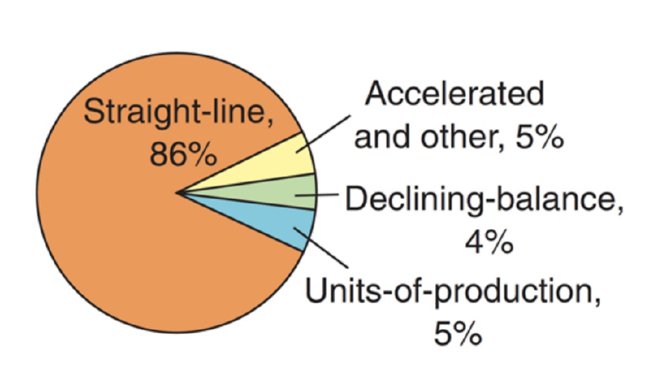
Methods of Depreciation
We will NOT test Sum-of-the-Year’s Digits
Notes:
The accelerated methods assume the asset is more efficient earlier in its life, therefore more depreciation is taken earlier and less later (= decreasing charge as asset ages).

Slide 23
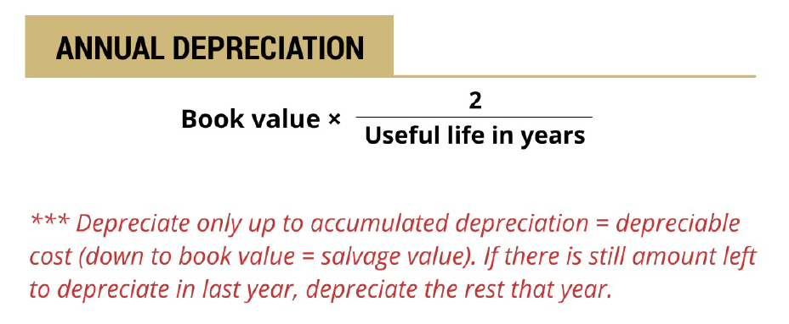
Double Declining Balance
Note: ignore salvage in calculation (manually stop)
Assumes asset is more productive at generating revenue early in its life (accelerates depreciation)

Slide 24
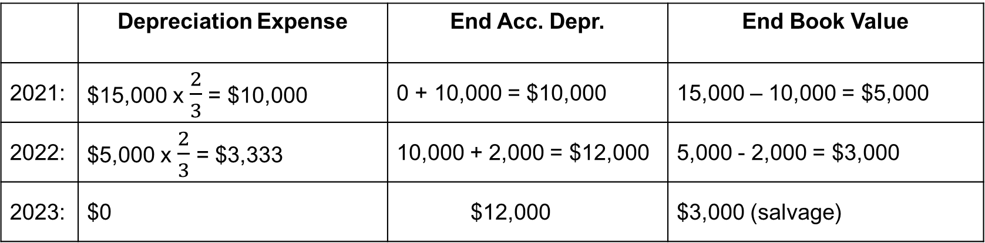


Example: Double Declining Balance
On January 1, 2021, Donuts-to-Go acquired a delivery truck at a cost of $15,000. The company estimates a useful life of three years and expects a salvage value of $3,000. Compute the depreciation expense for 2021, 2022, and 2023 using the double declining balance method.
 | Depreciation Expense | End Acc. Depr. | End Book Value
2021: | $15,000 x $\frac{2}{3}$ = $10,000 | 0 + 10,000 = $10,000 | 15,000 – 10,000 = $5,000
2022: | $5,000 x $\frac{2}{3}$ = $3,333 | 10,000 + 2,000 = $12,000 | 5,000 - 2,000 = $3,000
2023: | $0 | $12,000 | $3,000 (salvage)
2,000

Slide 25
Partial Year Depreciation

Slide 26
Partial Year Depreciation
How do we depreciate if PP&E is purchased (or disposed of) during the year?
Assume Full Month Convention: Pro-rate depreciation for the fraction of the year owned.
Count a full month of depreciation in the month purchased.
No depreciation in the month sold.
NOTE: Companies may have different policies for cutoff, such as half month.

Slide 27
Partial Year Example (straight-line)
On October 1, 2021, Donuts-to-Go acquired a delivery truck at a cost of $15,000. The company estimates a useful life of three years and expects a salvage value of $3,000.
Compute depreciation using the straight-line method for 2021, 2022, 2023 and 2024.
Annual depreciation =
(15,000 – 3,000) / 3 = $4,000
2021 depreciation:
$4,000 × 3/12 = $1,000
2022 depreciation:
$4,000
2023 depreciation:
$4,000
2024 depreciation:
$4,000 × 9/12 = $3,000

Slide 28


Pro-rating by depreciation method
First Year
Subsequent Years
Straight
-
Line
1.
Calculate a full year’s
Every year has a full year’s depreciation
depreciation amount.
except for last year, which records the
2.
Multiply by
$$\frac{\# of months owned}{12 months}$$
Remaining depreciable amount.
Units
-
of
-
Production
No change
–
calculate depreciation
No change
–
calculate depreciation
based on actual units produced
based on actual units produced.
Double Declining Balance
1.
Calculate a full year’s
Calculate like normal for each remaining
depreciation amount.
year. Depreciate to residual value.
$$\frac{\# of months owned}{12 months}$$
2.
Multiply by

Slide 29
In-class problem: Lump Purchase

Slide 30
Depletion (“Depreciation” for Natural Resources)
High Level Understanding

Slide 31
Depletion
Allocate cost of natural resources that are physically consumed over time (i.e., oil and gas, mining) and sold to customers.
Acquire
Natural Resource
Record Depletion
Each Period
Sell Resources
from Inventory
Capitalize historic cost on balance sheet as asset
Determine depletion base (historic cost - salvage)
Reduce asset directly for amount extracted using units-of-production
Amount removed goes to Inventory
Reduce inventory
Expense as Cost of Goods Sold

Slide 32
PP&E Life Cycle

Slide 33
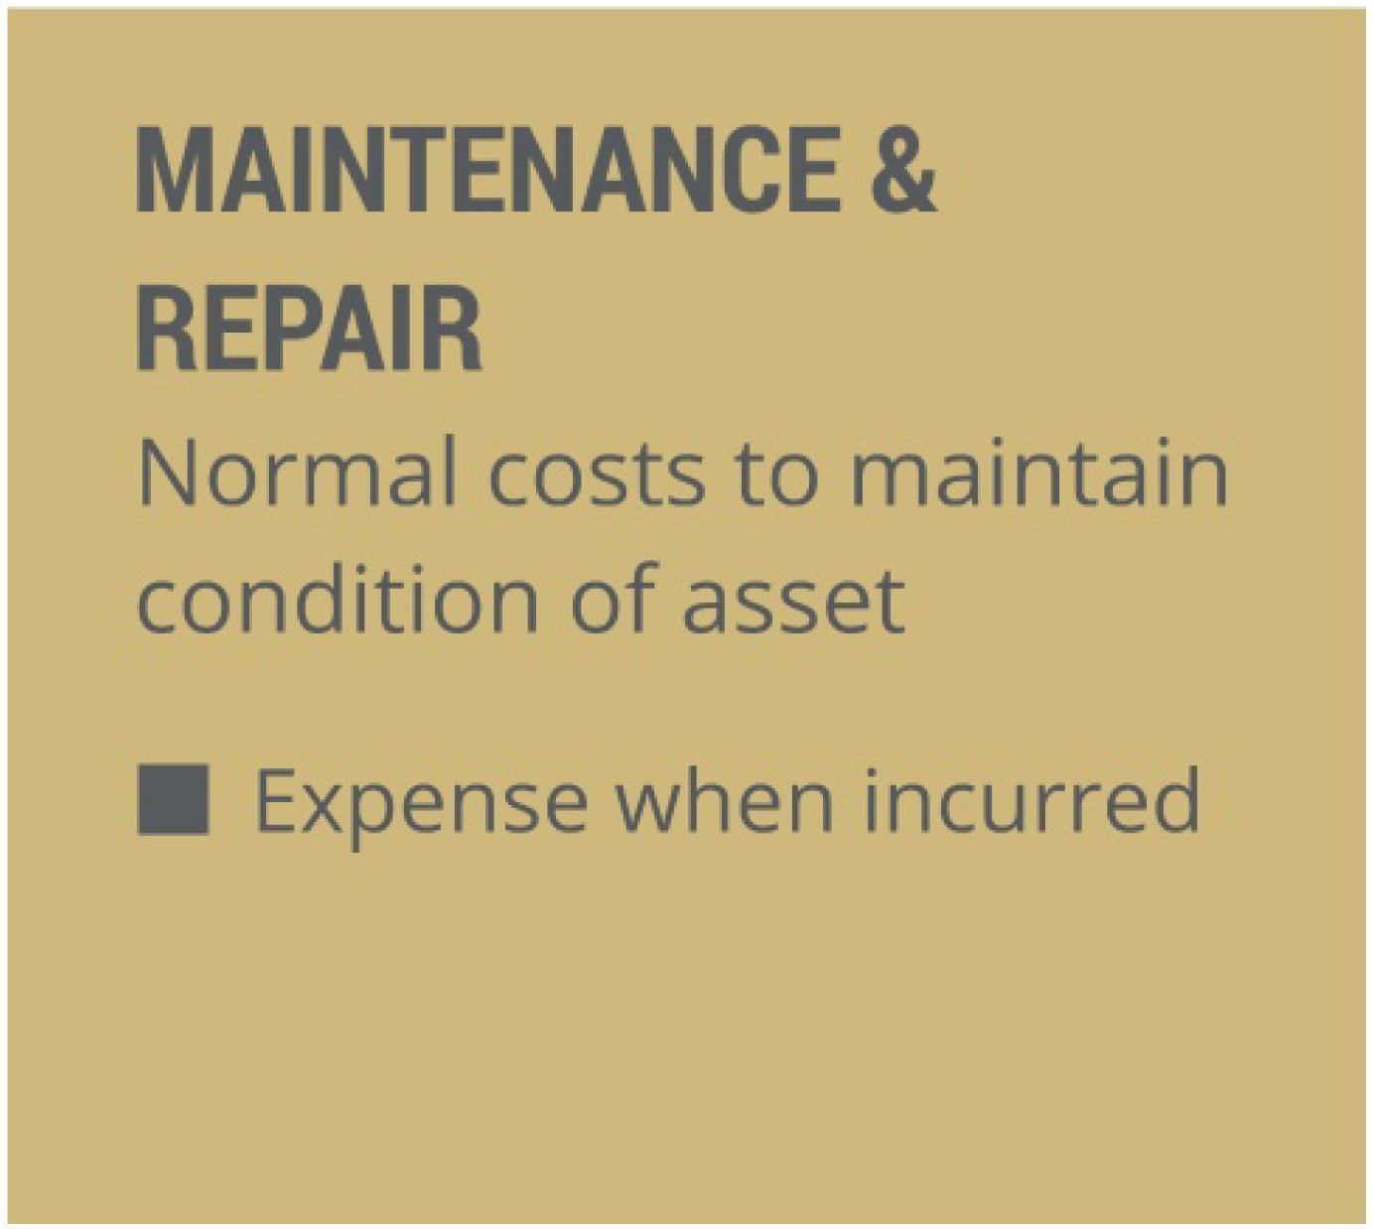
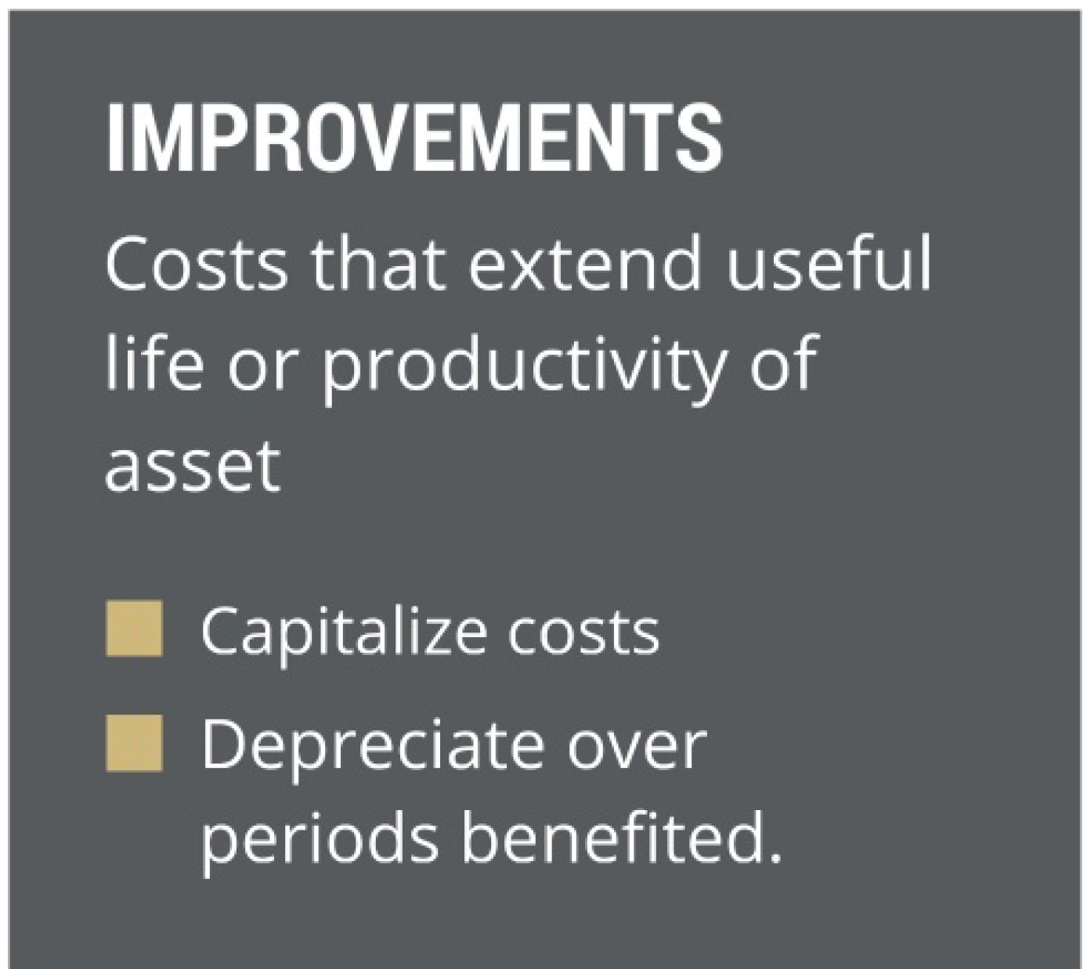
Post-acquisition expenditures
Issue: How to account for cash spent on maintenance, repairs, and improvements?
**Clearly, lots of subjectivity. Plus, practical cost-benefit issues.**
Notes:
Conceptually, there is a fine line: maintain vs. improve
Practically, firms may set a $ threshold
<$500 expense
>$500 capitalize

Slide 34
Example
Cave of Wonders Transportation made the following expenditures on its trucks during the current year:
$7,900 for oil and filter changes
$8,000 for installation of refrigeration systems in trucks so they can transport ice cream
$10,000 for engine overhauls to extend the fleet’s useful life
$4,500 for other ordinary repairs
Which of the above expenditures should be capitalized on the balance sheet (i.e., not immediately expensed)?
Notes:
Remember: inputs to depreciation are all estimates (useful life, salvage value, market value, improvements).
New information can arise along the way
-use machine differently than expected
-machine wears better/worse than anticipated
-add new functionality or extend life with expenditures

Slide 35
Property, Plant & Equipment Part 1 – In-Class

